Slide 1
Art Intensive

Slide 2


So 3D. What’s all that about? This week we find out! We’re going to talk about 3D, Maya and then we’re going to learn to model a fighter.
Key words for today:
#3D
#POLYGONS
#COMPONENTS
#MAYA
#HOTKEYS
#UI

Slide 3

#3D

Slide 4
#3D
2D plus another D!
3D is hip, it’s fresh it’s… Nope. It’s old.
It’s been with us in some form or another since before most of you were born.
But it’s the medium of the modern day videogame, visual effects, and much more.

Slide 5
#3D
2D plus another D!
So why would we want to do 3D as opposed to traditional/2D artwork???
What are the pros? What are the cons?
Up first, let’s look at the competition… 2D!

Slide 6

#2D

Slide 7

#2D
Not quite 3D
So 2D has been around even longer.
People have been making pictures move on film since the 1800’s.
People have been drawing in 2D since we lived in caves.

Slide 8
#2D
Not quite 3D
2D has many attractive qualities.
It’s a “What you see is what you get” medium.
You draw it, and there it is. Complete visual freedom, creativity and style!

Slide 9
#2D
Not quite 3D
The main detraction is when things start… Moving.
Animating a character in 2D means you redraw the character frame by frame.
Animating environments in 2D is complete nightmare!

Slide 10

#Stop Motion

Slide 11
#Stop Motion
3D. REAL 3D
So the most real that 3D can get, is stop motion (or Claymation if you prefer).
It’s an incredible medium.
Some of my favorite films ever put to screen are stop motion.
(See Nightmare Before Christmas, and Wallace and Grommet)

Slide 12
#Stop Motion
3D. REAL 3D
The pros here are that real objects are fairly easy to light, and hold a sense of believability.
The cons are that you require a great deal of skill to animate this well.
Real objects take up a lot of space, and there’s a huge amount of work involved in crafting the puppets and sets!

Slide 13

#CG

Slide 14
#CG
It’s what we’re here for.
CG 3D. Created in a program, it’s as flexible as your imagination.
As wide ranging in styles as there are stars in the sky.
You may be lulled to sleep by the dull brown greens of Call of Battlefield of Honor, but there is truly magic to be had in the realm of 3D art!

Slide 15
#CG
It’s what we’re here for.
The main issue with 3D is that all of the work is up front.
Creating a model, getting it textured…
Once you have it setup, you can reap the rewards and reuse your assets for as long as you want.

Slide 16
#CG
It’s what we’re here for.
Some other cool things with CG are the freedoms.
Your camera can be literally anywhere.
You can create lighting that would be expensive, or even impossible to create in the real world.
If you want to make films/commercials/games/apps or experiences, it’s a great skill to have!!!

Slide 17
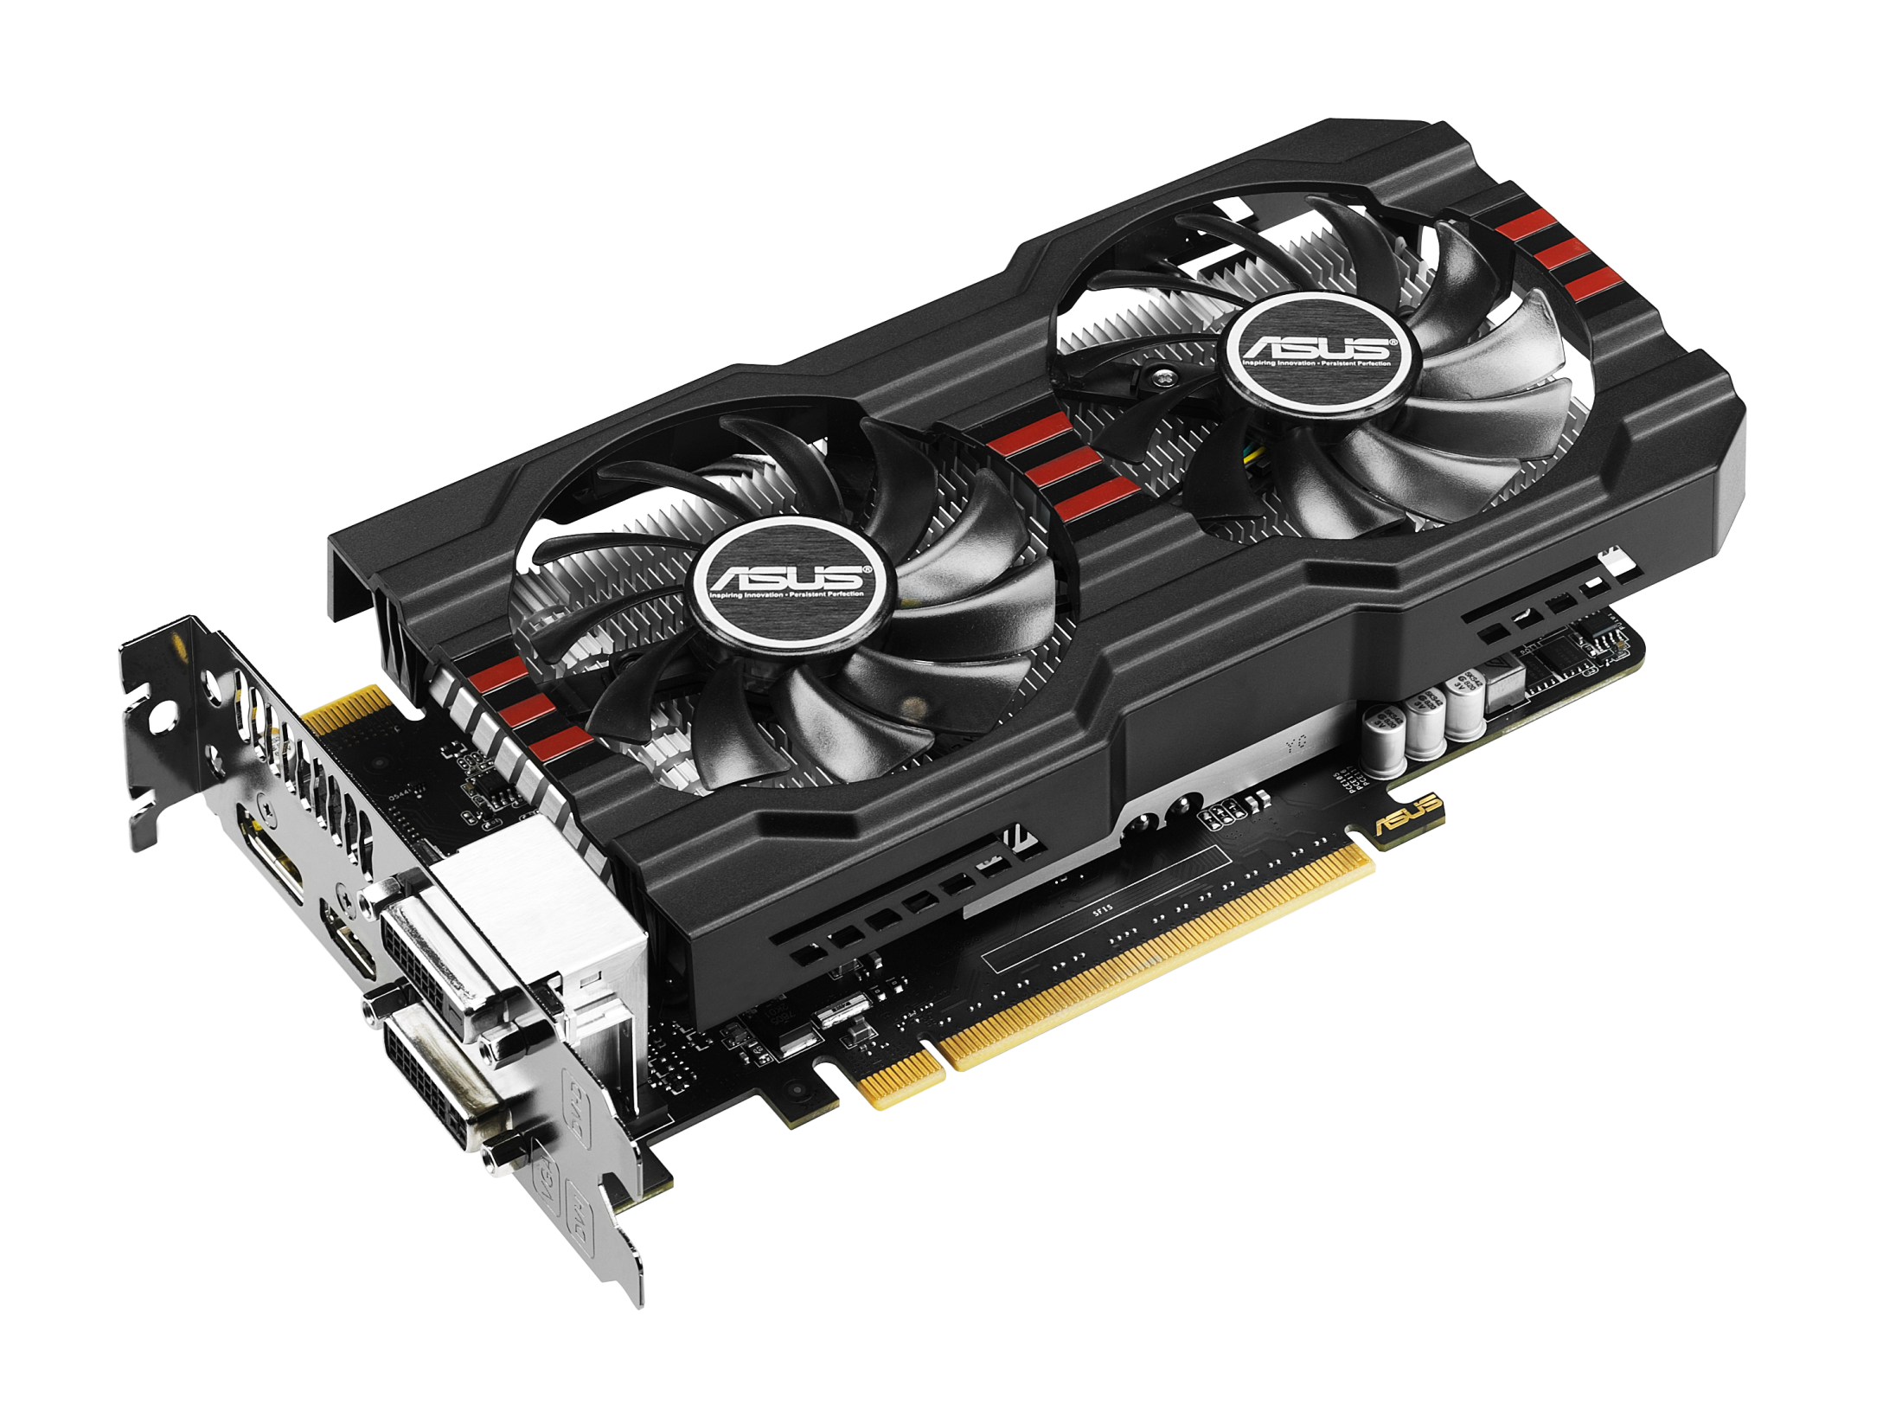
#REALTIME 3D
Games engines

Slide 18
#REALTIME 3D
Games engines
Everything in games is made of “POLYGONS”. From the trees, to the ground, to the characters.
Polygons in turn are constructed of triangles. Two triangles side by side build a “Quad” or square.
(Poly = Many, Gon = Corners)

Slide 19
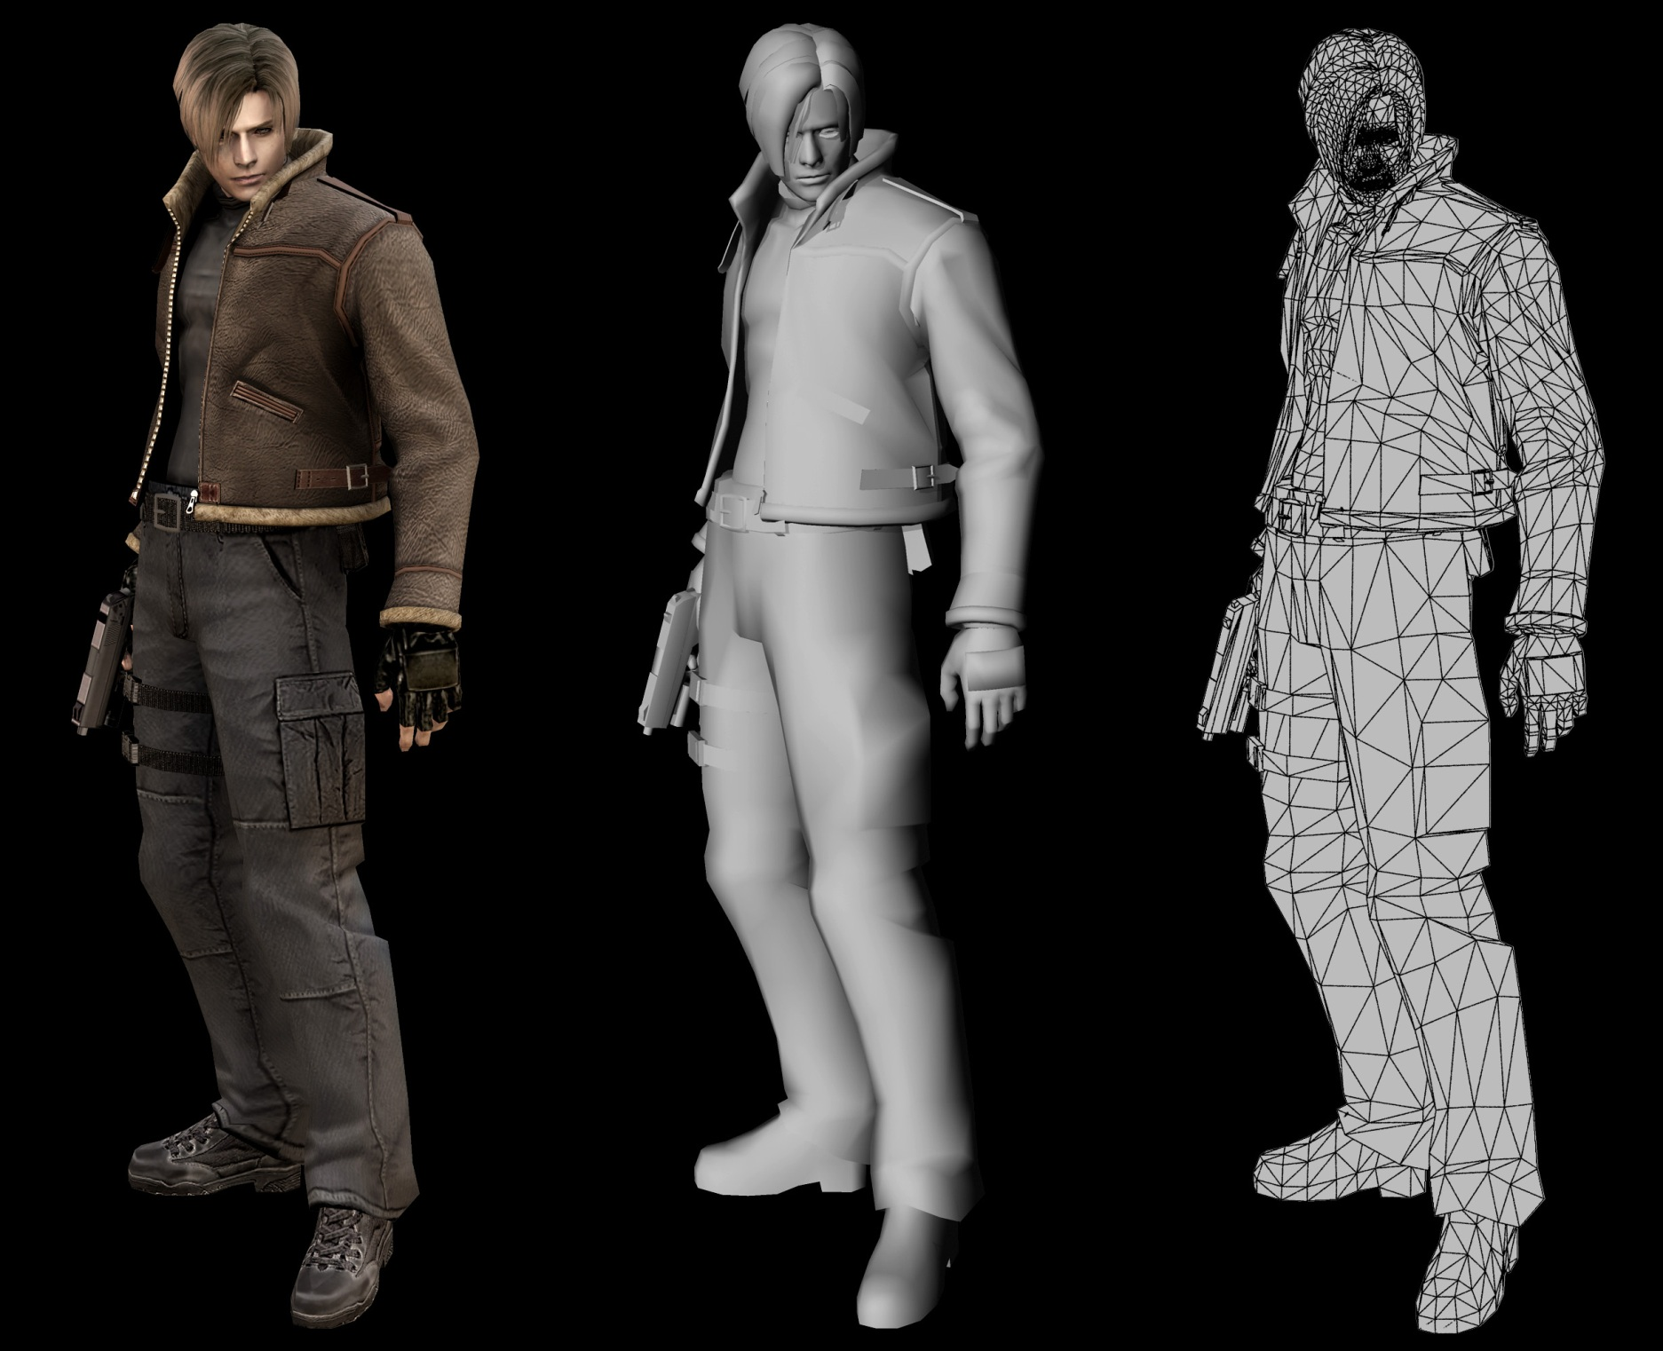
#REALTIME 3D

Slide 20
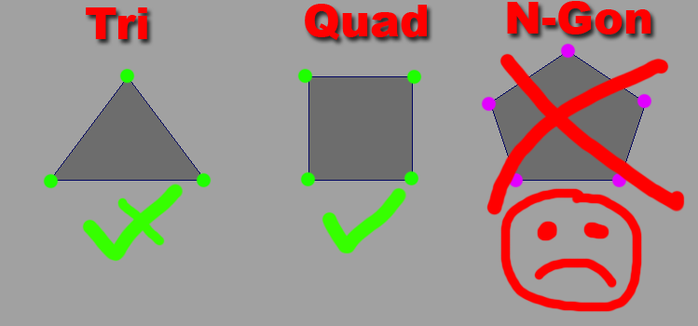
#REALTIME 3D
Games engines
When building polygons, one steadfast rule is that no polygon should be more than 4 sided (QUADS).
A three sided shape is fine (Henceforth to be called a TRI). A four sided shape is best (Hip to be square. Aka the humble QUAD). However, you build a 5 sided poly… And things get weird.
Dogs and cats, living together, mass hysteria. Games engines run on QUADS. You throw an extra angle into that equation and it tends to lose its mind.

Slide 21
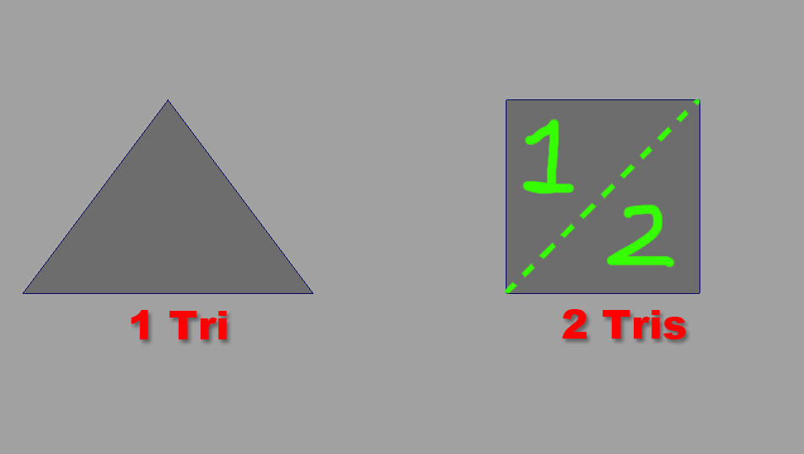
#REALTIME 3D
Games engines
Do you see how smooth that is there? 1 triangle, plus another triangle…
All of the sudden we’ve got a quad goin’. It’s beautiful!

Slide 22
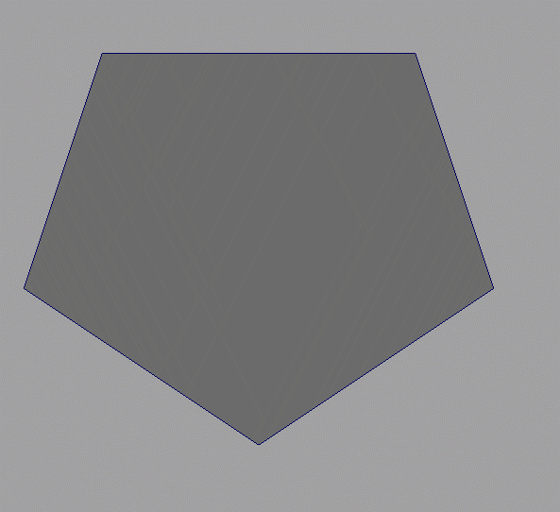
#REALTIME 3D
Games engines
NGONs. They’re bad. Really bad. Like get out of town bad. Don’t make them. Seriously. ☺
This five sided shape could be saved by cutting across the shape. Creating a Tri, and a Quad.

Slide 23
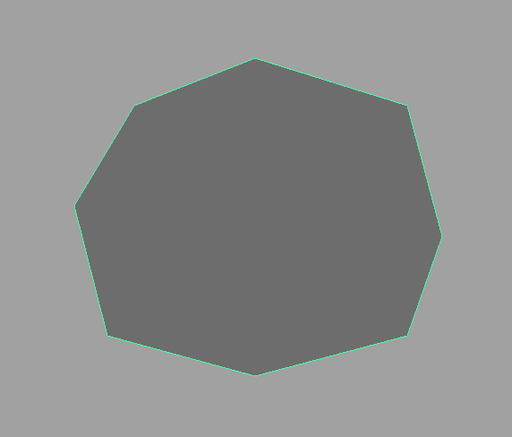
#REALTIME 3D
Games engines
Only thing worse than a 5 sided NGON… An 8 sided NGON (Or any number of sides).

Slide 24
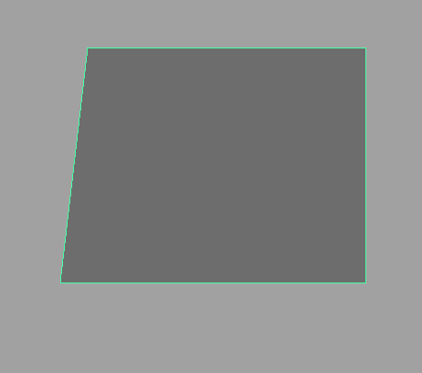
#REALTIME 3D
Games engines
NGONs are actually worst when you can’t see them… Like this little beauty!
We can just delete the extra vertices, and the edges will take care of themselves.

Slide 25
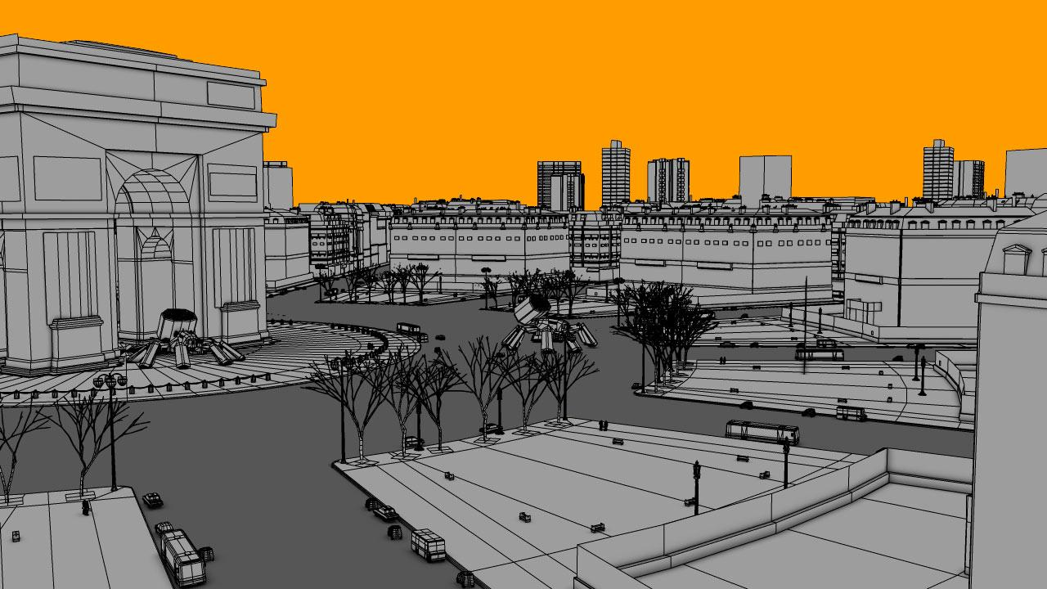
#REALTIME 3D

Slide 26
#COMPONENTS
Falling to pieces
To build things in 3D, you first need to understand your building blocks. Your COMPONENTS if you will.
FACES: Faces are the flat surfaces of polygons. They’re what you see when you play a game.
VERTICES: Vertices are the dots or points in space that are used to draw the faces of a model.
EDGES: Edges are the lines that connect the points or vertices together to surround a face.

Slide 27
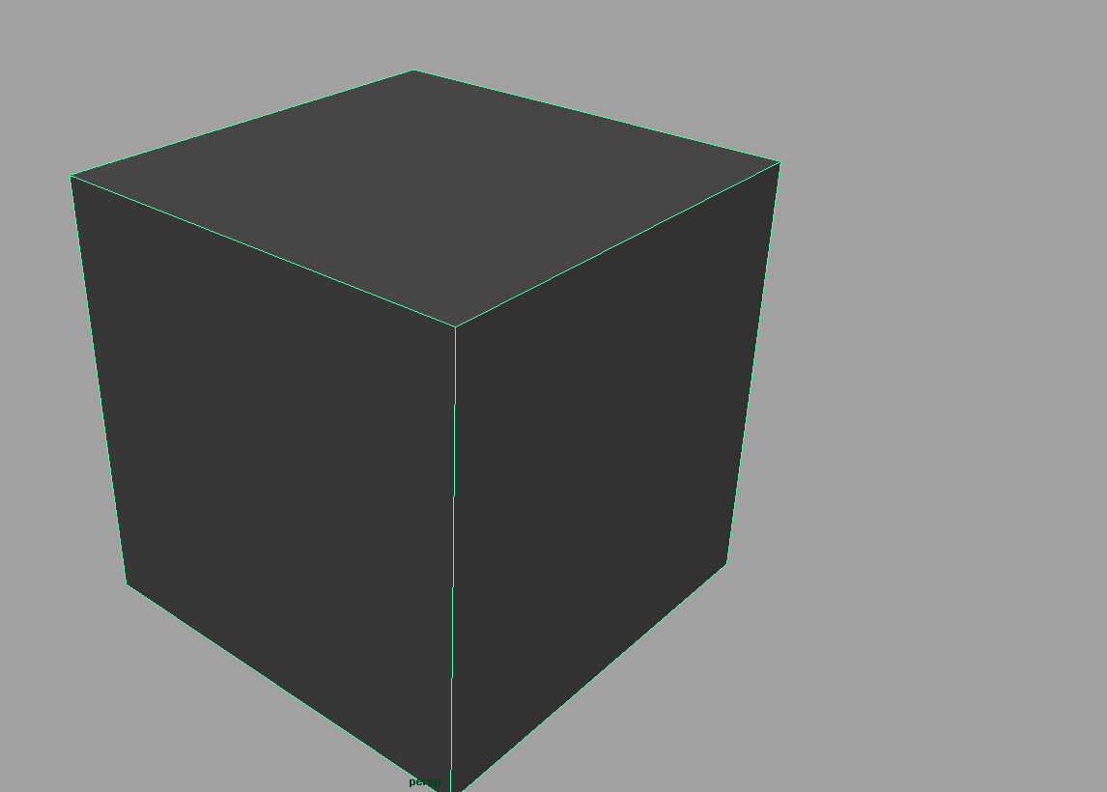
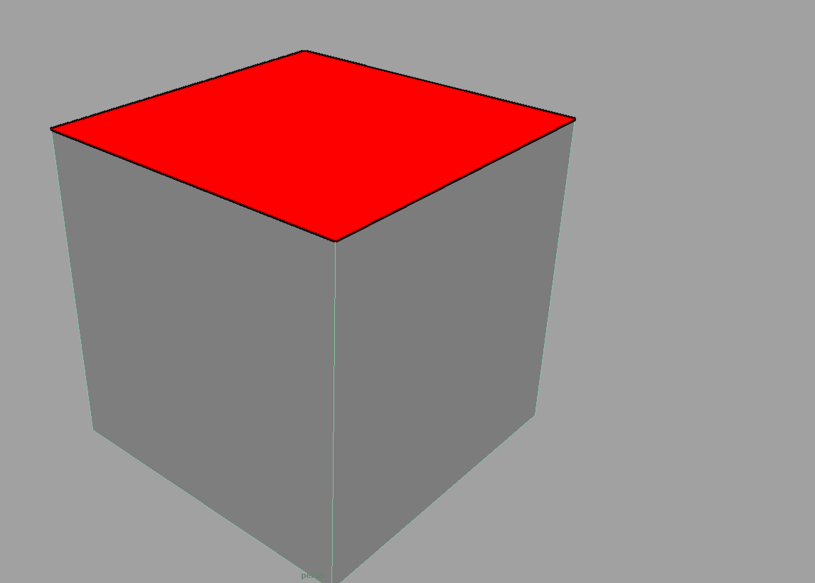
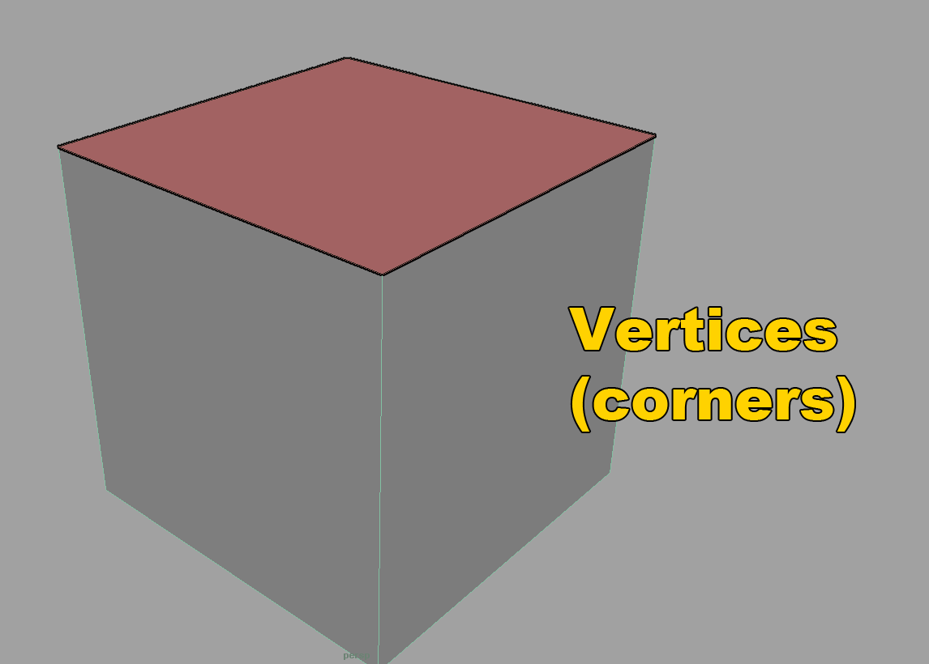
#COMPONENTS
Falling to pieces

Slide 28
#COMPONENTS
Falling to pieces
NORMALS. Every face has a Normal. Vertices also have Normals.
NORMALS are the direction that a component is facing.
If you are looking straight on at a surface, than more than likely that faces’ surface normal is looking right back at you.
We’ll get more into NORMALS and advanced concepts later on.

Slide 29

#MAYA

Slide 30
#MAYA
Some kind of monster
MAYA is a giant sprawling beast. It is full of intrigue and mystery.
It is powerful enough to be used in the biggest productions, from film to games.
You can do everything in here…

Slide 31
#MAYA
Some kind of monster
You can make a basic blueprint of a level in it.
Create detailed environments and character models…
You can simulate physics, create particle systems. You can even code scripts inside of Maya.

Slide 32
#MAYA
Some kind of monster
If you know another piece of 3D software, that’s awesome.
Max, Blender, XSI, Houdini, they’re all greats.
We use MAYA because it’s one of the most widely used programs on the market today.

Slide 33
#UI
Microsoft Excel from hell.
Let’s take a trip through the vast cavern that is the UI of MAYA!
Viewports & swapping views
-Viewports in Maya are where we do our work.
-They aren’t just limited to regular views either!
-You can quickly swap views by tapping the SPACEBAR
Perspective vs Orthographic views
-The cameras in the viewports can either be with perspective, or without (orthographic)
-Each has their own pros and cons.
-When modeling from reference use Orthographic views.
-When checking a model for form and errors, use Perspective views.

Slide 34
#UI
Microsoft Excel from hell.
Menus & Status Line
-The menus and status line at the top of UI are home to many great tools.
-Here you will find the different Snapping tools, Rendering menus and more.
Shelf/Shelves
-One of the most useful tools in Maya is just a shelf to keep your tools!
-Shelves have tabs to let you select what tool set you want to work with.
Timeline & Range Slider
The Timeline is the key to Animation in Maya. It is home to your key frames.

Slide 35
#UI
Microsoft Excel from hell.
Command Line & Output
The Command Line and Output give you information about what is going on in Maya at the time.
If you see red down here, you’re experiencing an error.
If you plan to be a technical artist, or an engineer that supports artists, you can write MEL scripts.
Channel Box & Attribute Editor
-You’ll spend a LOT of time in the Channel Box and the Attribute Editor!
-The tabs at the right side of the interface allow you modify the attributes of meshes and shaders.
-The Channel Box also has the Layers menu which allows you to show/hide objects.

Slide 36
#UI
Microsoft Excel from hell.
Modelling Tool Kit
-A set of tools “borrowed” from other programs which makes Maya a modeling powerhouse.
-A bunch of these tools exist elsewhere in the UI, but they are all subtly different.
-You can bevel edges, extrude faces, bridge gaps, cut faces & target weld anything!

Slide 37

#INTERMISSION
Time for a little Q & A:
Who is ready to build a snowman?
Do you like fun???

Slide 38
RESOURCES
Now that we’re looking at 3D, here are some resources to help you on your way!
Beginner Maya Tutorials: http://www.3dtotal.com/index_tutorial.php?catDisplay=2&subcat=20&sort=date&order=1&detailsoff=0&roPos=1
Learning Maya Youtube channel: https://www.youtube.com/user/MayaHowTos
Autodesk Tutorials: http://area.autodesk.com/mayalearningpath
Autodesk Knowledge Network: http://knowledge.autodesk.com/support/maya/getting-started/caas/CloudHelp/cloudhelp/ENU/123112/files/maya-learning-path-html.html

Slide 39


